Slide 1
SRI AUROBINDO: THE ALIPORE INCIDENT
BY AABHA, AARON, DIVJOT AND AROHI

Slide 2
Summary
The case
Sri Aurobindo was suddenly arrested on the 2nd of May. It was sudden for him as he was in slumber. The police had arrested him for being a part of the Alipore bomb case. And conspiracy. This arrest was accompanied by the taking into custody of other young revolutionaries as well. Sri Aurobindo’s trial began on the 19th of May which was dragged onward with preliminary cases in the Magistrate’s court followed by a Session Court during which the arrested people were solitarily confined in the torturous conditions of Precedency Jail. After the elongated trial of an entire year the verdict was delivered by the judge and Sri Aurobindo was imprisoned in Alipore Jail.
In Prison
Sri Aurobindo was first lodged in a complete solitary cell, then later transferred to a shared room in which there were prisoners of the same case and finally again in a singular cell. During this time, Sri Aurobindo practiced meditation, yoga and read spiritual books and Gita and the Upanishads even if other prisoners made sounds of their presence. He did experience a sense of distress but because of his spiritual presence, he felt relaxed and supremely blissful, as he said himself. His belief in yoga, spirituality and God grew much more. He believed that a prayer could link Man’s strength to a transcendent Force.

Slide 3
God Everywhere, In The Court Too
In the prison, Sri Aurobindo was completely tranquil. He did not feel hopeless and desperate; he felt as if he was surrounded and enveloped by the presence of Vasudeva or God. He says “I walked under the branches of the tree in front of my cell, but t was not a tree, I knew it was Vasudeva, it was Krishna whom I was standing there and holding over me his gaze. I looked at the bars of my cell, the very grating that did duty for a door and again I saw Vasudeva. It was Narayan who was guarding and standing sentry over me..”
In all aspects of his life, he felt the presence of God around him. His words also say “Or I lay on the coarse blankets that were given for me a couch and felt the arms of Sri Krishna around me, the arms of my Friend and Lover…. I looked at the prisoners in jail, the thieves, the murderers, the swindlers, and as I looked at them, I saw Vasudeva, it was Narayana whom I found in these darkened souls and misused bodies.”
Even in the court, he saw Vasudeva when he looked at the Magistrate, he saw Sri Krishna when he looked at the Prosecuting Counsel. His soul was barely in the trial as he was so absorbed in meditation that he ignored question and only listened to the Voice within him which repeated “I am guiding, therefore fear not. Turn to your own Work for which I have brought you to jail.”
Supernatural Experiences
Sri Aurobindo’s spiritual experiences grew much, and he started hearing the voice of Vivekanand for an entire fortnight in his meditation. It spoke on a special field of spiritual experience and ceased. He also experienced levitation where he effortlessly was suspended in mid air. This has attracted the entire country’s attention. Day after day, his spiritual journey expanded as he found himself having experiences which no material science could explain

Slide 4
Released
As Sri Aurobindo began to listen to his intuition, the voice at the back of his head, or as he calls it, the Voice inside, one of his friends offered to defend him on his Judgement Day. Sri Aurobindo was going to guide him for the day, but the Voice inside told him that he was the man who would get him out of prison. On the day, he gave a brilliant speech and with that, Sri Aurobindo was released from prison.
After he was released, Sri Aurobindo decided to study meditation and yoga in depth. He also gave a lot of speeches, the Uttarpara speech being his debuting one where thousands of people listen to his historical speech in silence and peace. He educated people and motivated them to move forward, towards, even closer to independence.
This resulted in the governments attempts to remove him again, and when this happened, his inner Voice spoke to him, telling him to go to Chandannagore.

Slide 5
GODHEAD
The perception
- Sri Aurobindo
The meaning of the word “Godhead” is God, and from that it is evident that the poem is about God and Sri Aurobindo's awareness and devotion for Him. In the Pome, he expresses how, when he experiences discomfort and approaching danger the supreme being touched him which gave him infinite serenity. He highlights to us that we frequently feel as though the Divine is guiding us with his eternal embrace enveloping our soul. He talked about the way he felt as though a majestic body was looming over him, guiding, protecting, and assisting him in fearlessly overcoming all evil. He explains how the Supreme radiates a sense of peace, immortality and satisfaction and with his gaze he is capable of turning everything in sight to wonders. Sri Aurobindo recollects how he, in the arms of the lord, witnesses the entire universe, the sun,
the breeze, the trees, the water and the soil as part of the divine. He realizes that the lord that
he envisions, is himself and eternal calmness that he saw will be brought by his own hands. After that brief vision of truth, Sri Aurobindo recognizes his objective and the significance of using integral yoga to bring everyone eternal peace.
I sat behind the dance of Danger’s hooves
In the shouting street that seemed a futurist’s whim,
And suddenly felt, exceeding Nature’s grooves,
In me, enveloping me the body of Him.
Above my head a mighty head was seen,
A face with the calm of immortality
And an omnipotent gaze that held the scene
In the vast sun and breeze;
The world wavicle of its sovereignty.
His hair was mingled with the s in His heart and He was I:
I housed in me the Everlasting’s peace,
The strength of One whose substance cannot die.
The moment passed and all was as before;
Only that deathless memory I bore.

Slide 6
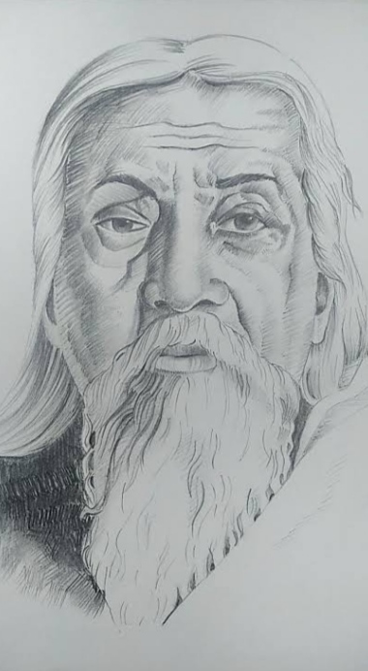
Artwork- portrait by Aarohi

Slide 7
Thank you

